Slide 1
Parallelogram in Quadrilateral
Notes:
See Geogebra resource “Quadrilateral Investigation.ggb” to create more resources or demonstrate live.

Slide 2
Using the grid to help you, mark the midpoint of each side of the quadrilateral.
Join these midpoints, in order, to form a new quadrilateral inside the original one.
What do you notice about your new quadrilateral?
Repeat the process on another quadrilateral.
Compare your results with others.
What similarities do these parallelograms have?
What’s the area of the parallelogram? What’s the area of the quadrilateral? Can you prove the relationship?
How could you draw more quadrilaterals with exactly the same property?

Slide 3
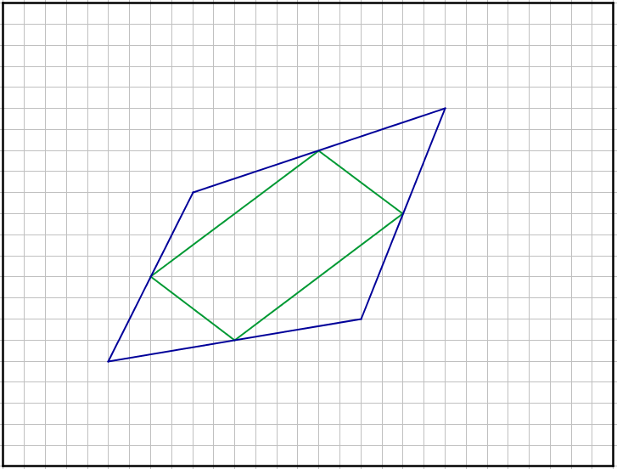
A

Slide 4
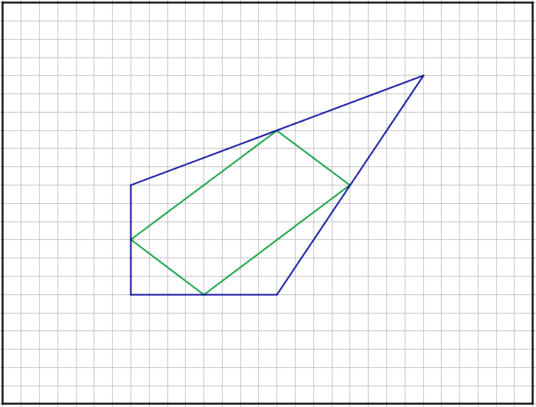
B

Slide 5
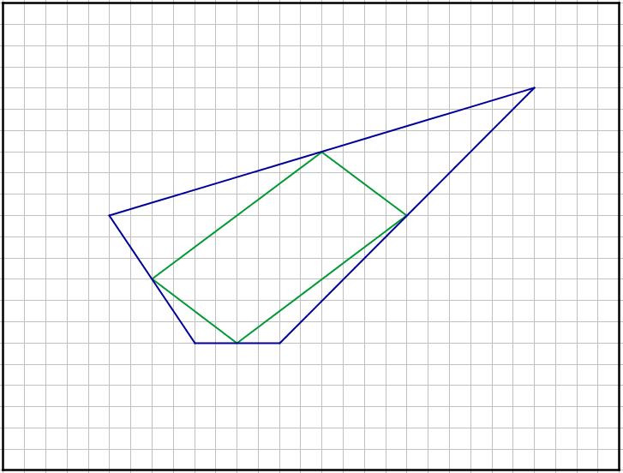
C

Slide 6
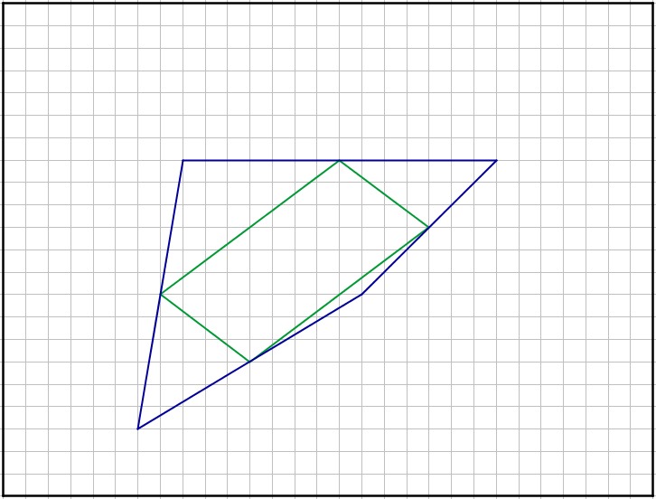
D

Slide 7
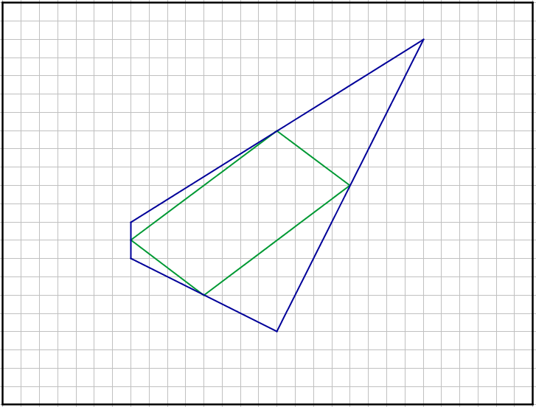
E

Slide 8
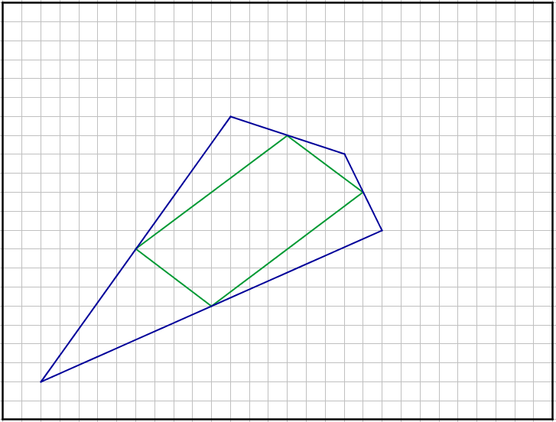
F

Slide 9
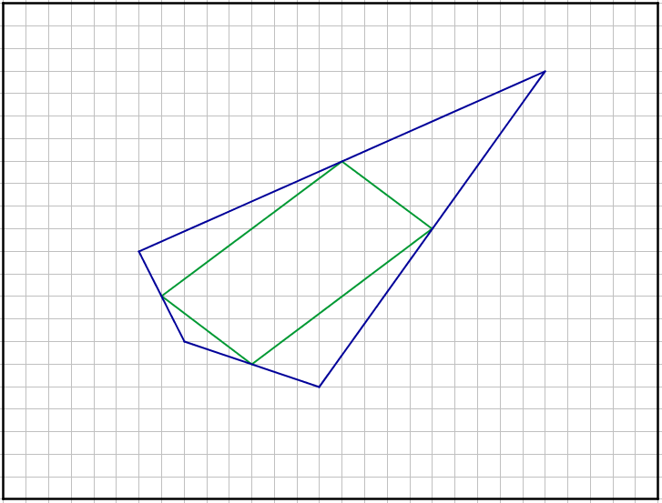
G

Slide 10
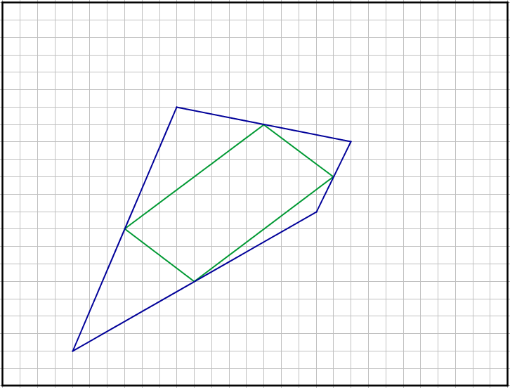
H

Slide 11
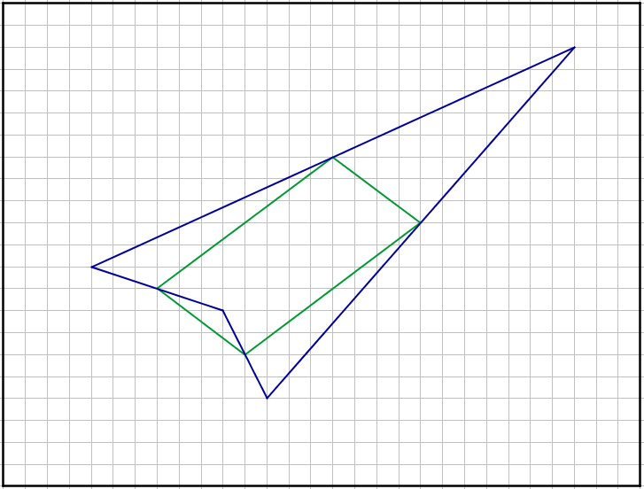
I

Slide 12
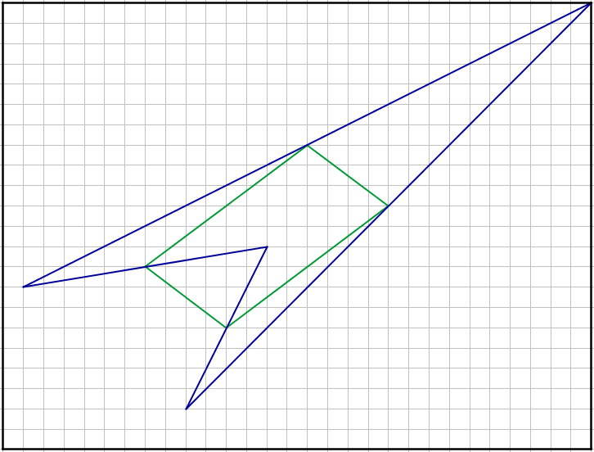
J

Slide 13
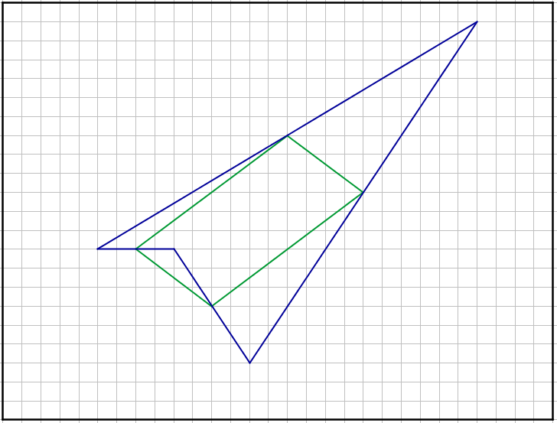
K

Slide 14
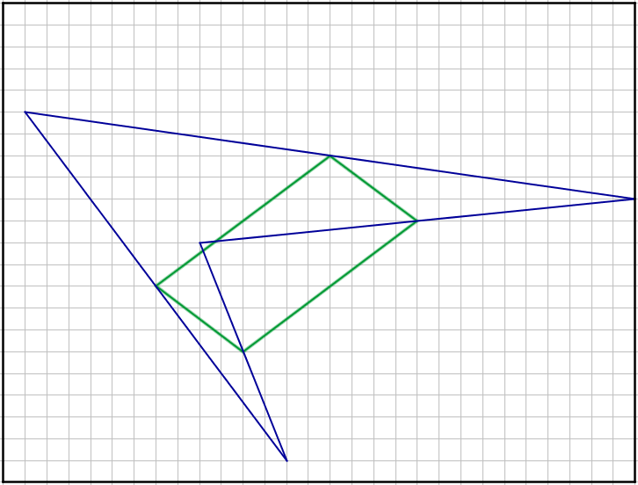
L

Slide 15
All of the quadrilaterals are different in shape…
But all of the parallelograms are identical!
Can you explain this?
All of the quadrilaterals are similar in some respects. Which respects?
The midpoints of each side are coincident
They all have the same area
Can you prove why the area is the same?

Slide 16
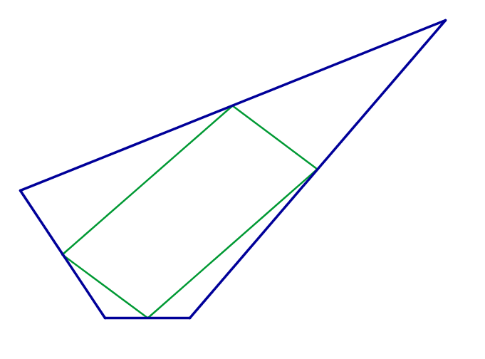




What is the area of the parallelogram compared to the area of the enveloping quadrilateral?
$$B$$
$$C$$
$$O$$
$$A$$

Slide 17
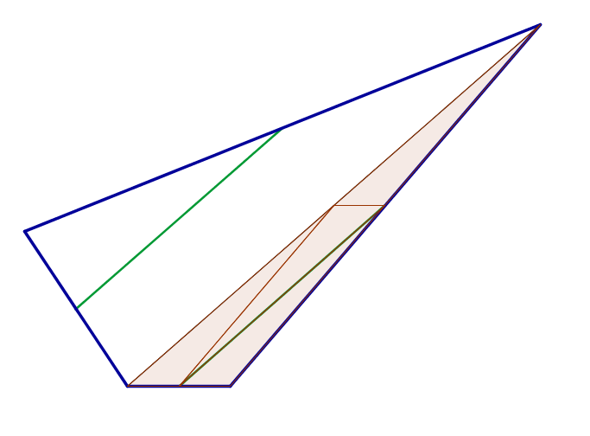
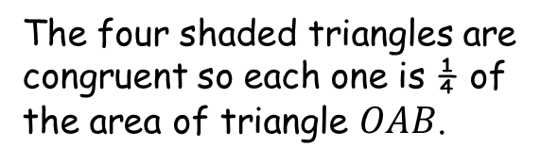
$$B$$
$$C$$
The four shaded triangles are congruent so each one is ¼ of the area of triangle $OAB$.
$$O$$
$$A$$

Slide 18
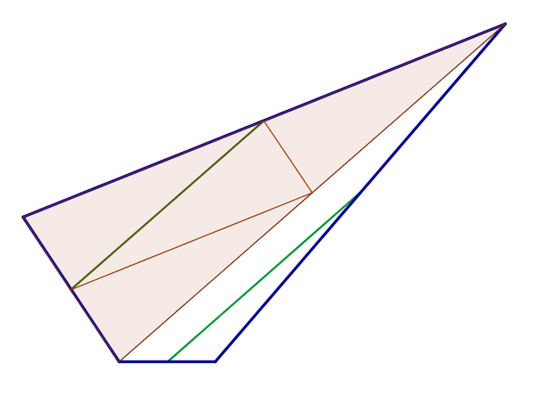
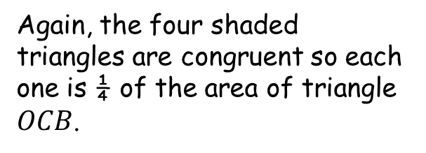
$$B$$
$$C$$
Again, the four shaded triangles are congruent so each one is ¼ of the area of triangle $OCB$.
$$O$$
$$A$$

Slide 19
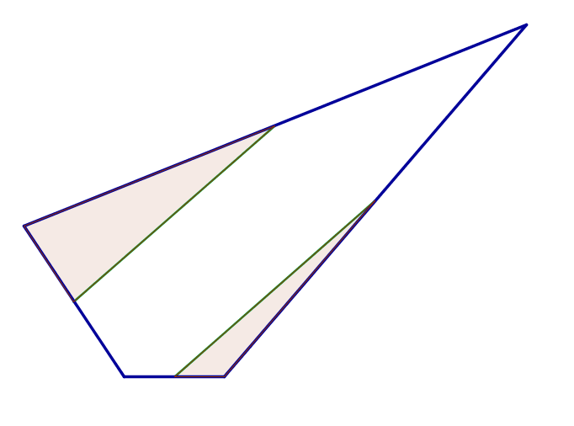
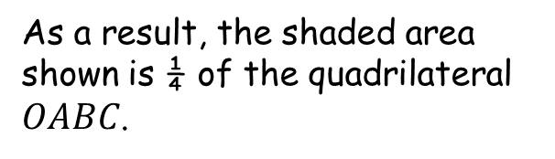
$$B$$
$$C$$
As a result, the shaded area shown is ¼ of the quadrilateral $OABC$.
$$O$$
$$A$$

Slide 20
Let’s remind ourselves of the original diagram.
$$B$$
$$C$$
$$O$$
$$A$$

Slide 21
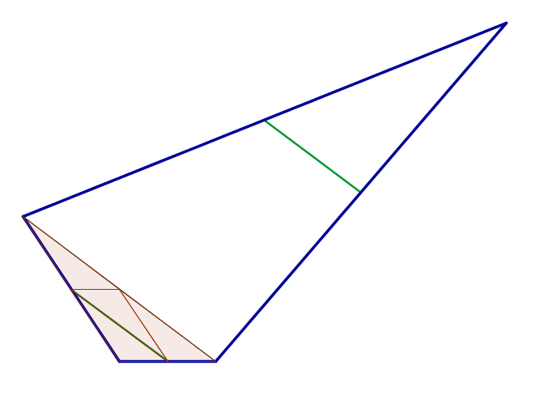
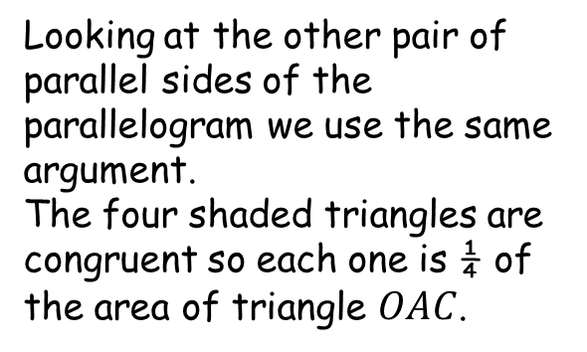
$$B$$
$$C$$
Looking at the other pair of parallel sides of the parallelogram we use the same argument.
The four shaded triangles are congruent so each one is ¼ of the area of triangle $OAC$.
$$O$$
$$A$$

Slide 22
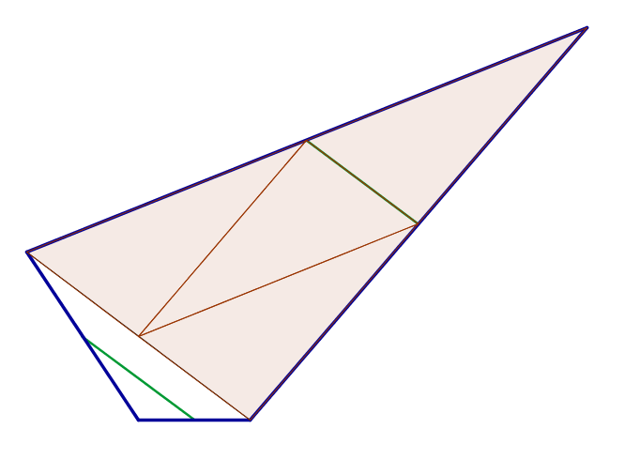
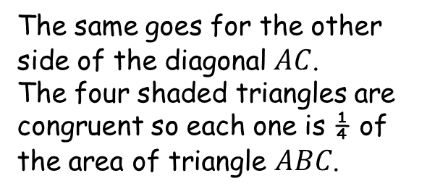
$$B$$
$$C$$
The same goes for the other side of the diagonal $AC$.
The four shaded triangles are congruent so each one is ¼ of the area of triangle $ABC$.
$$O$$
$$A$$

Slide 23
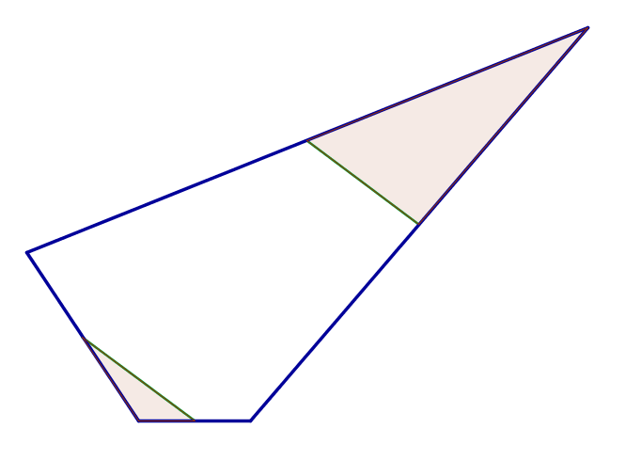
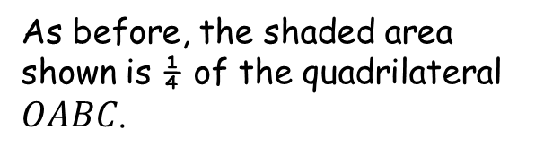
$$B$$
$$C$$
As before, the shaded area shown is ¼ of the quadrilateral $OABC$.
$$O$$
$$A$$

Slide 24
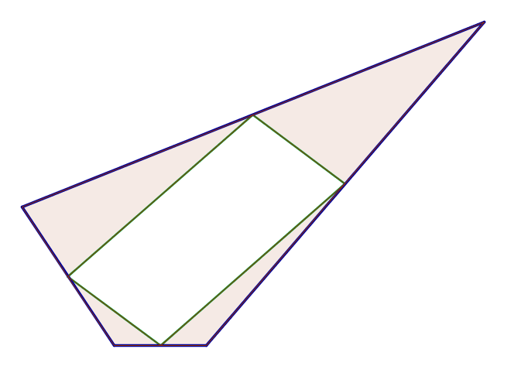

$$B$$
$$C$$
Putting our previous results together, we can say that the shaded area shown must be ½ of the area of the quadrilateral $OABC$.
Therefore, the parallelogram must also have an area equal to ½ of the quadrilateral $OABC$.
$$O$$
$$A$$

Slide 26
Resources
With grid

Slide 27
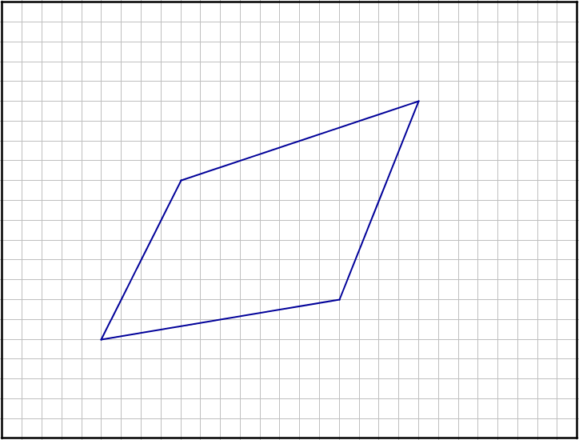
A
SIC_3

Slide 28
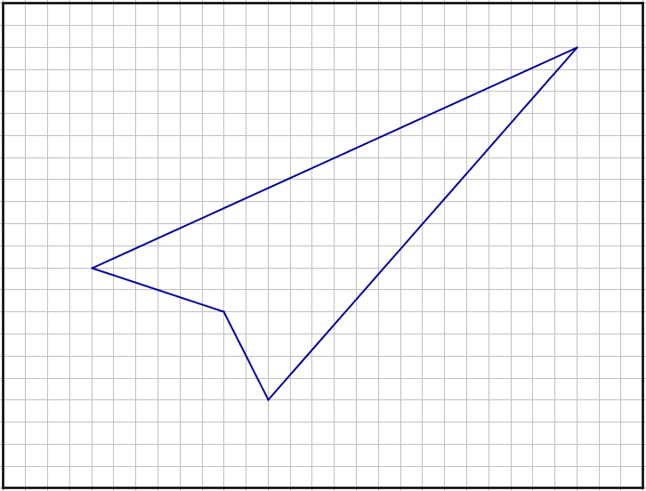
I
SIC_3

Slide 29
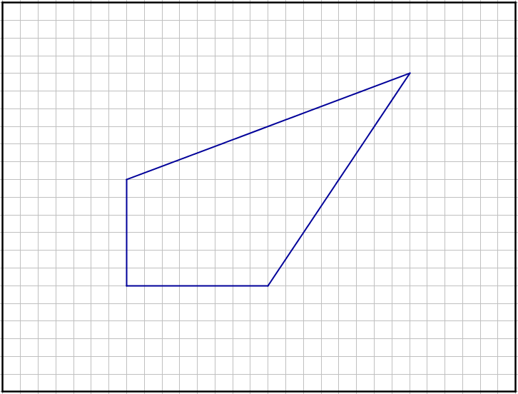
B
SIC_3

Slide 30
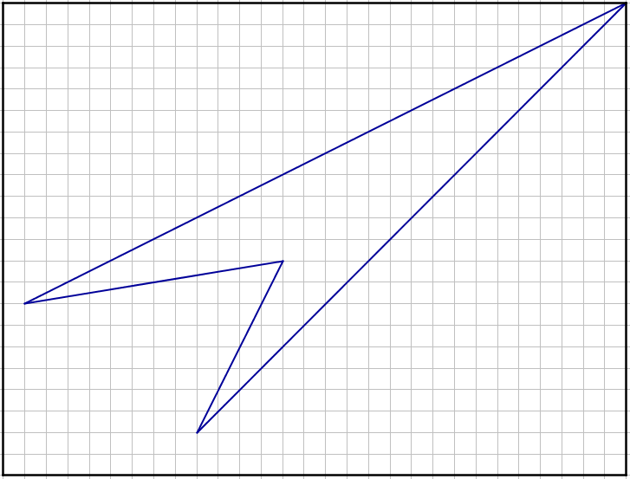
J
SIC_3

Slide 31
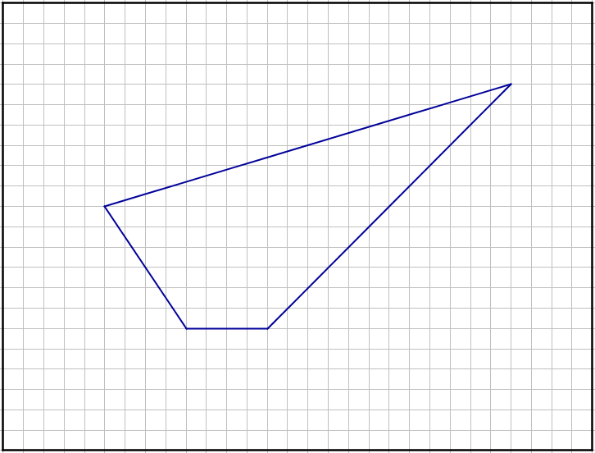
C
SIC_3

Slide 32
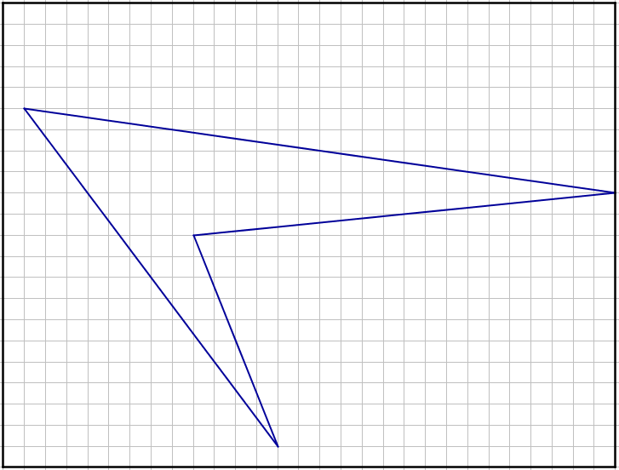
L
SIC_3

Slide 33
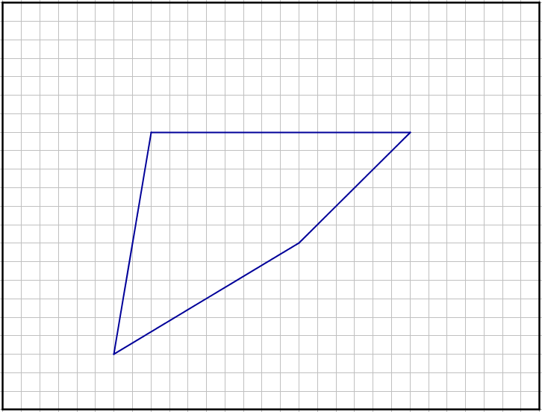
D
SIC_3

Slide 34
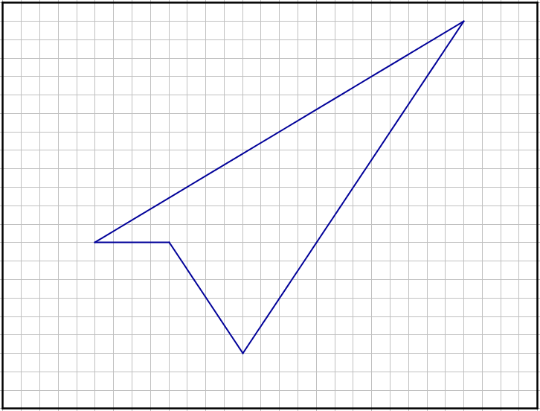
K
SIC_3

Slide 35
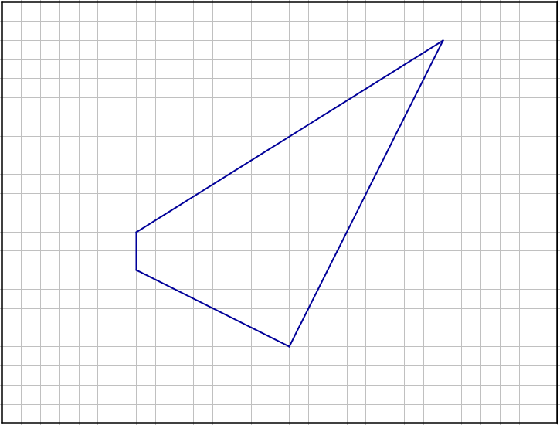
E
SIC_3

Slide 36
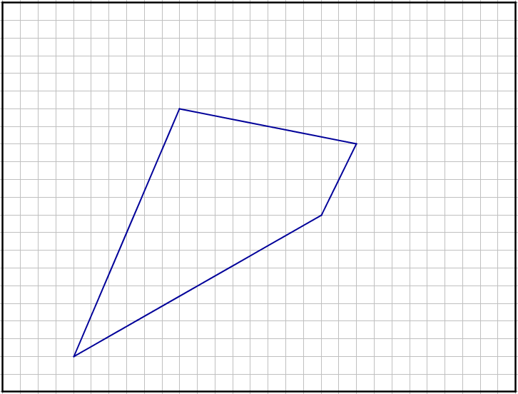
H
SIC_3

Slide 37
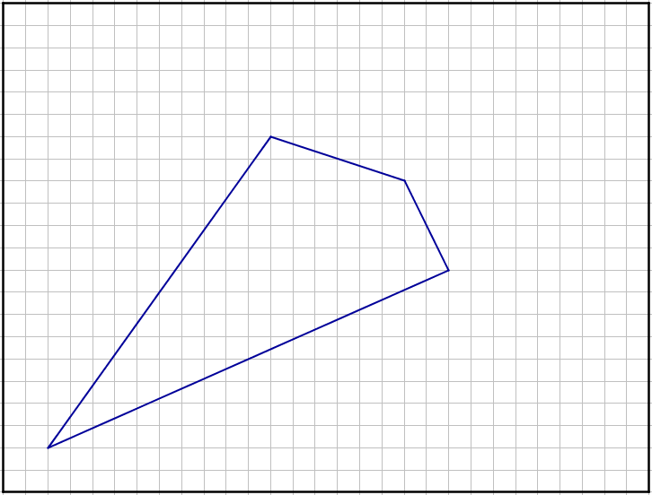
F
SIC_3

Slide 38
K
SIC_3

Slide 39
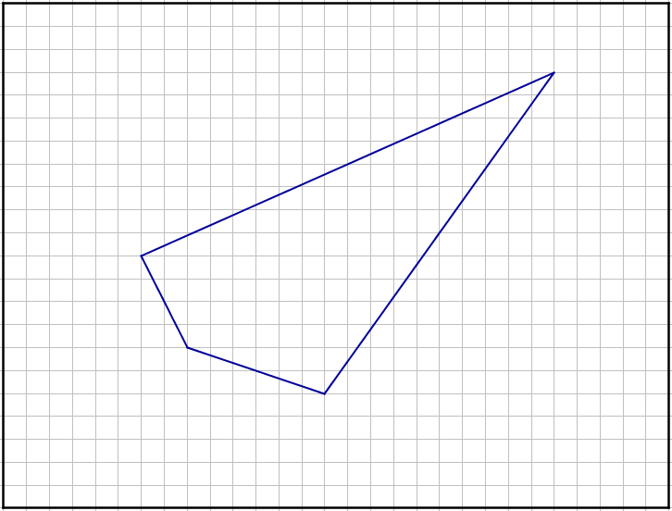
G
SIC_3

Slide 40
L
SIC_3

Slide 41
H
SIC_3

Slide 42
E
SIC_3

Slide 43
I
SIC_3

Slide 44
B
SIC_3

Slide 45
J
SIC_3

Slide 46
C
SIC_3

Slide 47
K
SIC_3

Slide 48
H
SIC_3

Slide 49
L
SIC_3

Slide 50
A
SIC_3

Slide 51
J
SIC_3

Slide 52
L
SIC_3

